Slide 1
GYM DATA ANALYSIS
-Sivasree

Slide 2
Interpretation
General Insights
Performance & Health Metrics
Comparative Analysis

Slide 3
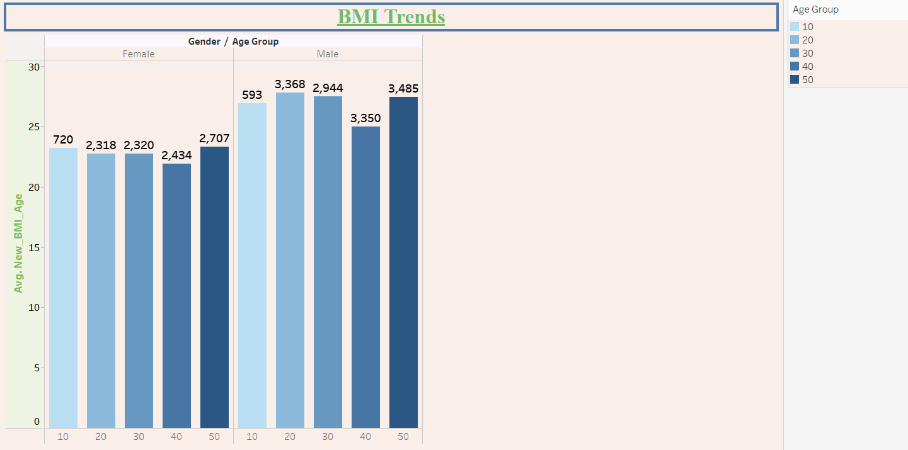
What is the distribution of BMI across different age groups?

Slide 4
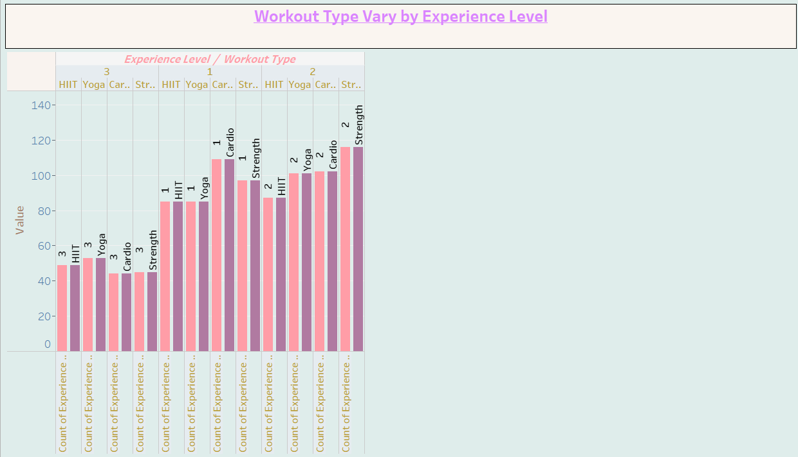
How does Workout_Type vary by Experience_Level?

Slide 5

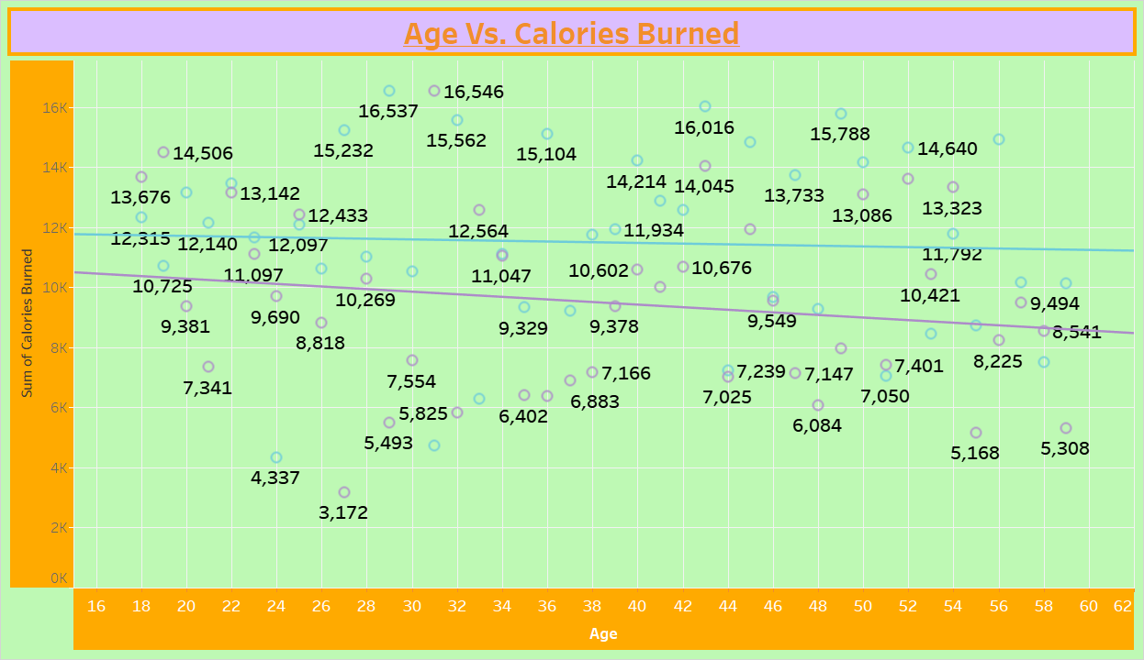
What is the relationship between Age and Calories_Burned?

Slide 6
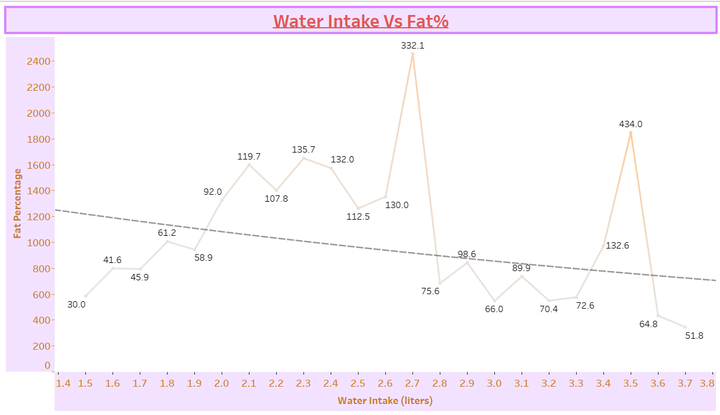
How does Water_Intake correlate with Fat_Percentage?

Slide 7
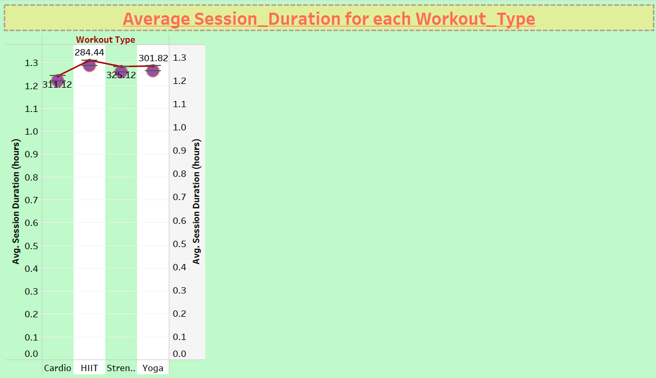
What is the average Session_Duration for each Workout_Type?

Slide 8
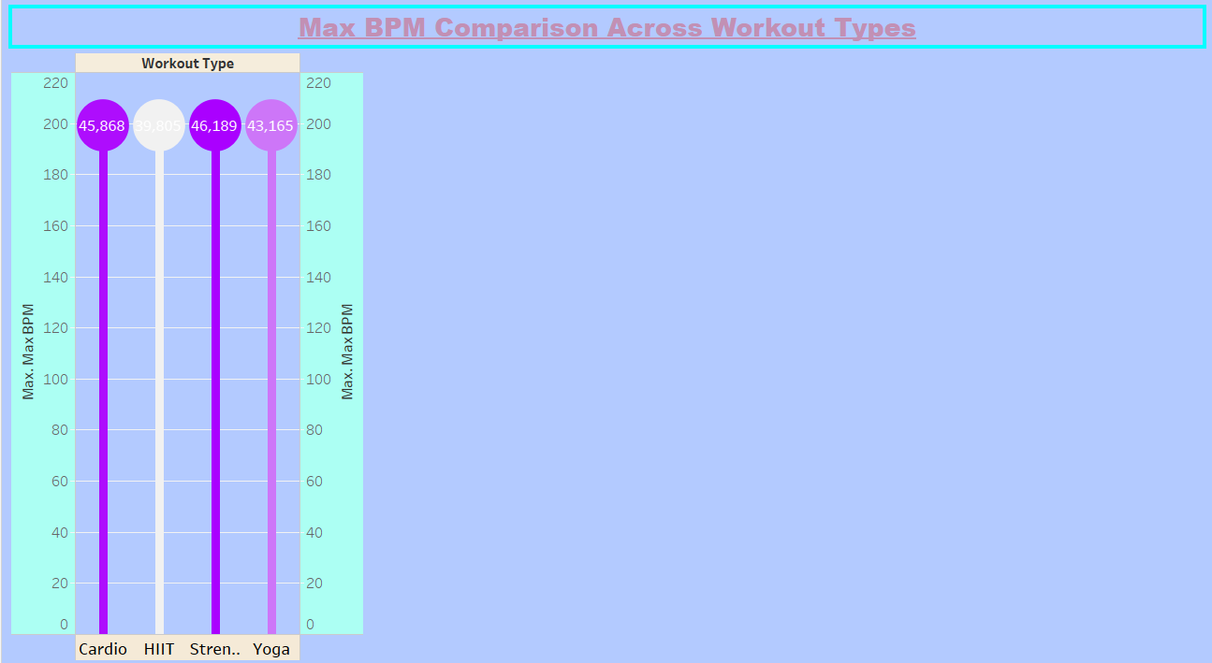
How does Max_BPM differ among Workout_Types?

Slide 9
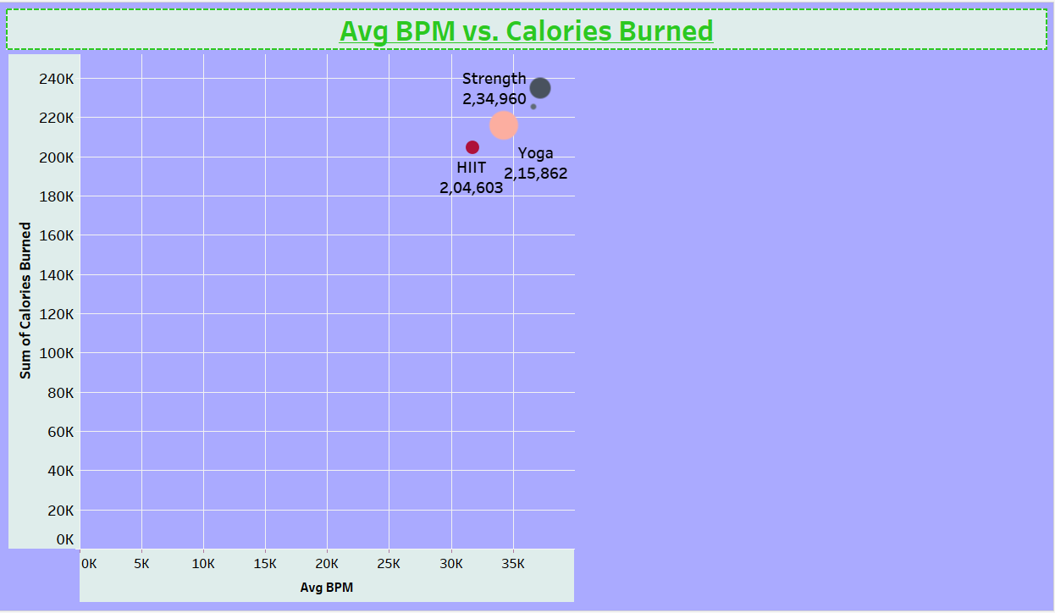
What is the trend between Avg_BPM and Calories_Burned?

Slide 10
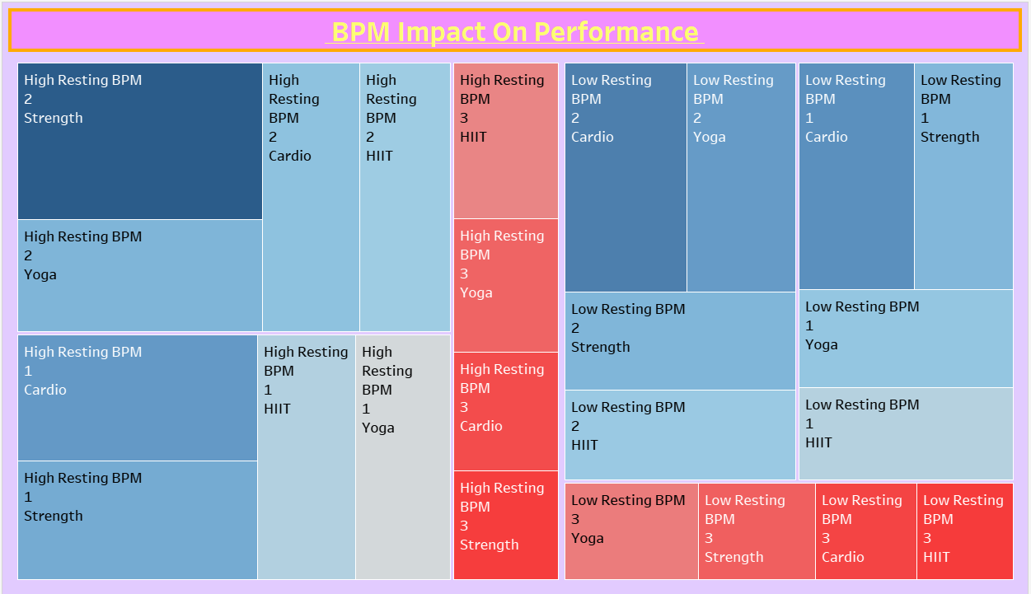
How do users with a high Resting_BPM perform compared to those with a lower Resting_BPM?

Slide 11
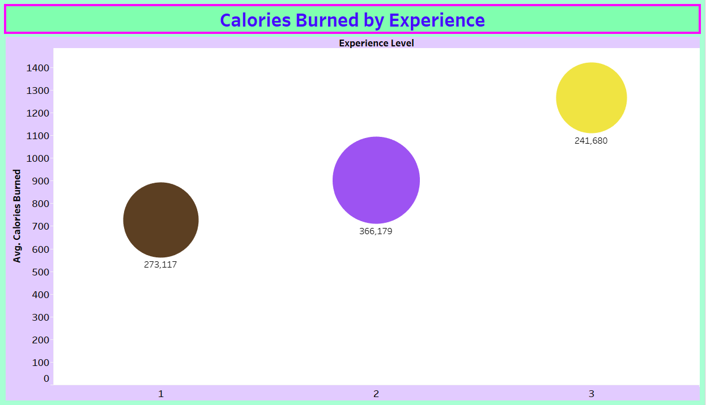
Which Experience_Level burns the most calories on average?

Slide 12
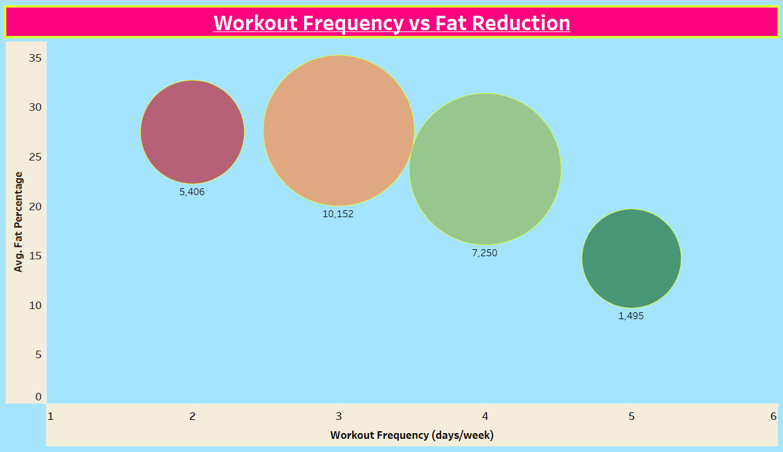
How does Workout_Frequency impact Fat_Percentage reduction?

Slide 13
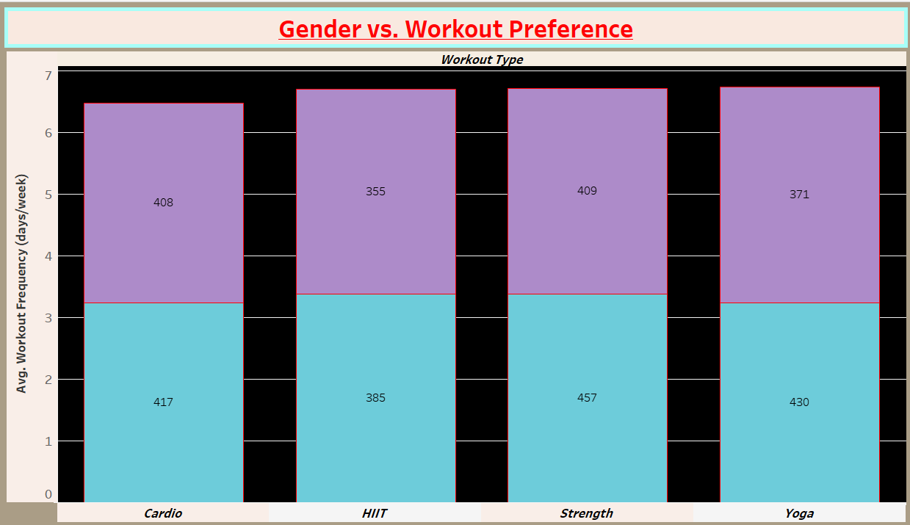
How does Gender influence Workout_Type preference?

Slide 14
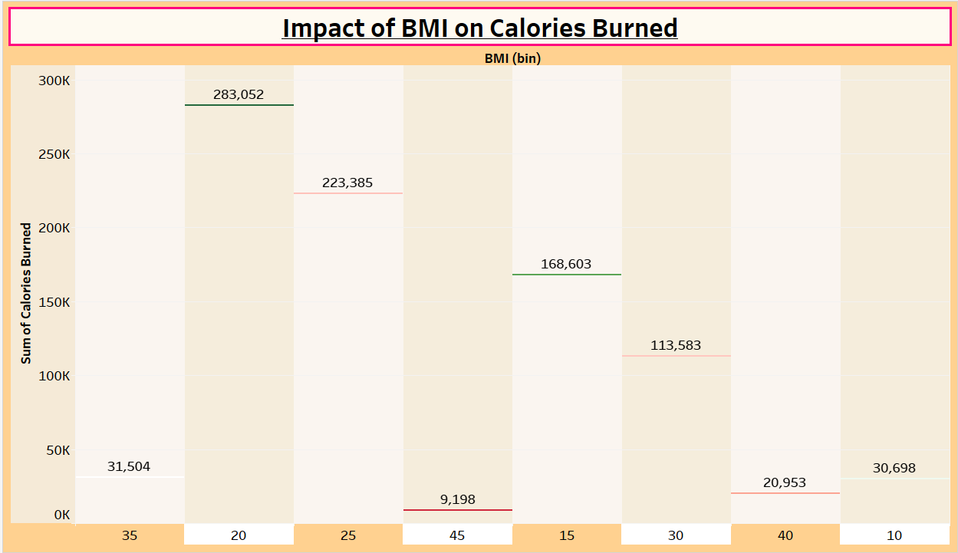
What are the differences in Calories_Burned among users with similar BMI levels?

Slide 15
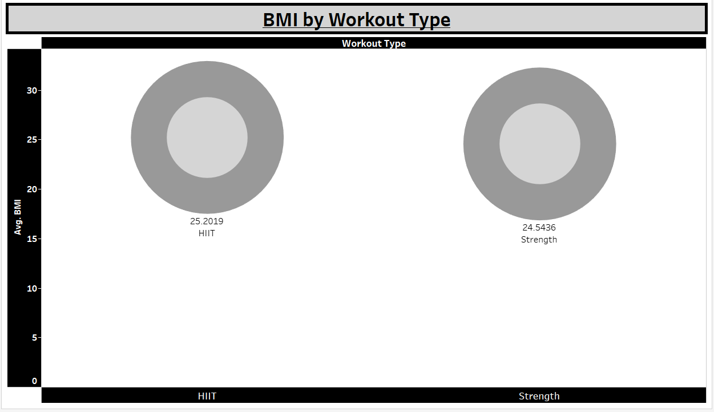
Is there a significant difference in BMI for users who perform HIIT vs. Strength training?

Slide 16
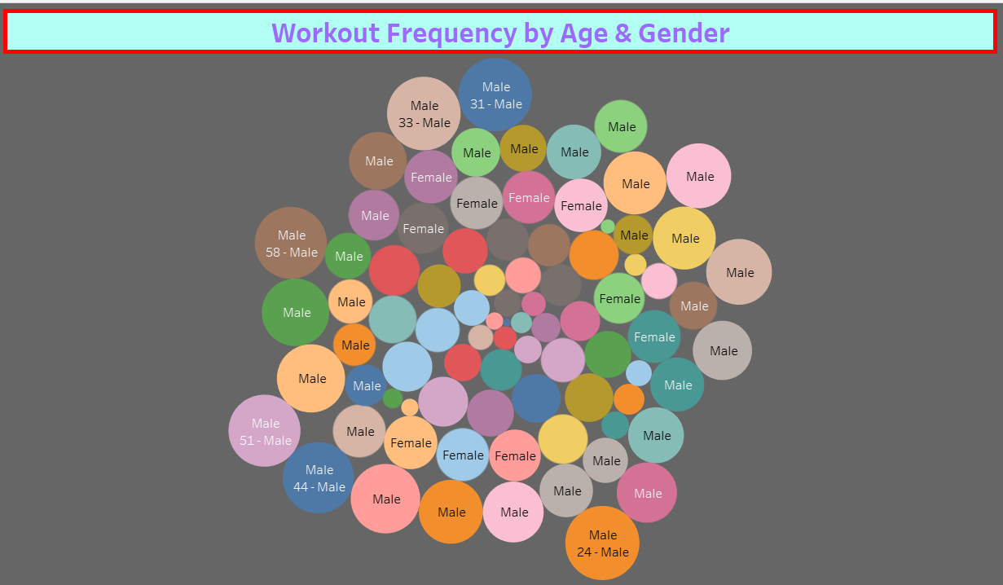
Which demographic (Age & Gender) has the highest Workout_Frequency?

Slide 17
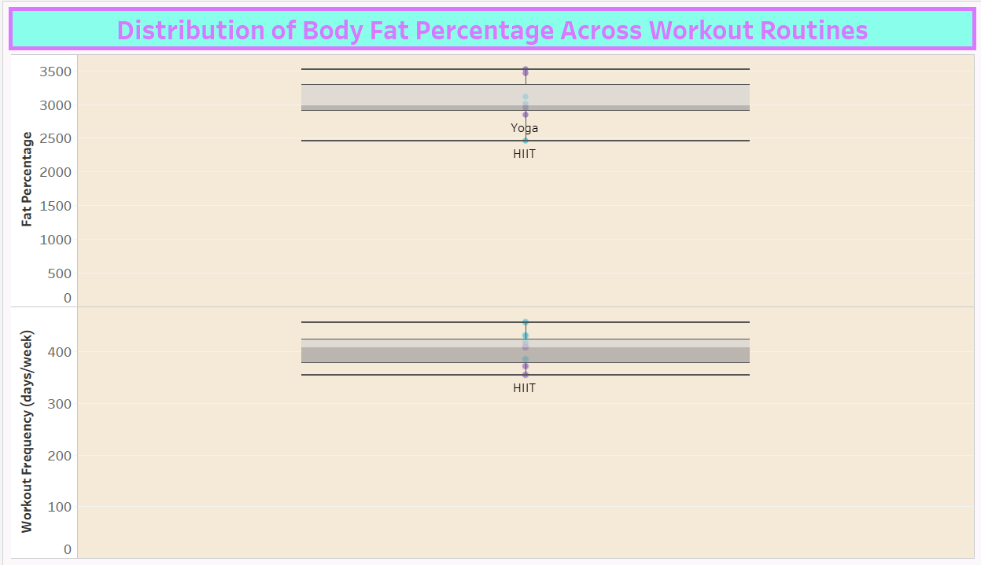
How does Body Fat Percentage differ for users with similar workout routines?

